Slide 1
Digital Portfolio
STUDENT NAME: AKSHAY. S
REGISTER NO AND NMID: autunm11024ca101
DEPARTMENT: Computer Application
COLLEGE: University of Madras

Slide 2
PROJECT TITLE
MODERN PORTFOLIO WEBSITE

Slide 3


AGENDA
Problem Statement
Project Overview
End Users
Tools and Technologies
Portfolio design and Layout
Features and Functionality
Results and Screenshots
Conclusion
Github Link
3/21/2024 Annual Review

Slide 4

PROBLEM STATEMENT
In the current digital age, exhibiting professional abilities, projects, and accomplishments requires an online presence. Presenting their work in an orderly and appealing manner is a challenge for many freelancers and students. This issue is resolved by a portfolio website, which serves as both an online professional resume and a personal brand identity.

Slide 5

PROJECT OVERVIEW
This project is a website for my personal portfolio that showcases my accomplishments, projects, and abilities. The portfolio offers a methodical approach to showcasing my identity, activities, and contact details. It is modern, interactive, and completely responsive, guaranteeing device accessibility.

Slide 6

WHO ARE THE END USERS?
End Users
Students – who want to showcase academic achievements, projects, and skills.
Recruiters/Employers – to evaluate skills and experience.
Clients – who may want to hire me for freelancing projects.
Peers/Collaborators – who are interested in networking and team projects

Slide 7

TOOLS AND TECHNIQUES
Tools and Technologies
Frontend: HTML, CSS, JavaScript
Hosting: GitHub Pages
Design Tools: Figma

Slide 8
POTFOLIO DESIGN AND LAYOUT
The portfolio is divided into clear sections:
Hero Section – Introduction with animated roles (Web Developer | Web Designer | Freelancer).
About Me – Personal background, skills, and interests.
Skills Section – Display of technical expertise in frontend, backend, and tools.
Projects Section – Highlight of major projects with descriptions.
Contact Section – Contact form and social media links.
Footer – Copyright and navigation.
8

Slide 9
FEATURES AND FUNCTIONALITY
Responsive design (works on desktop, tablet, and mobile).
Animated typing effect for roles.
Interactive hover effects on skills and projects.
Contact form with validation.
Social media icons with links (GitHub, LinkedIn, Email).
Smooth scrolling navigation.

Slide 10
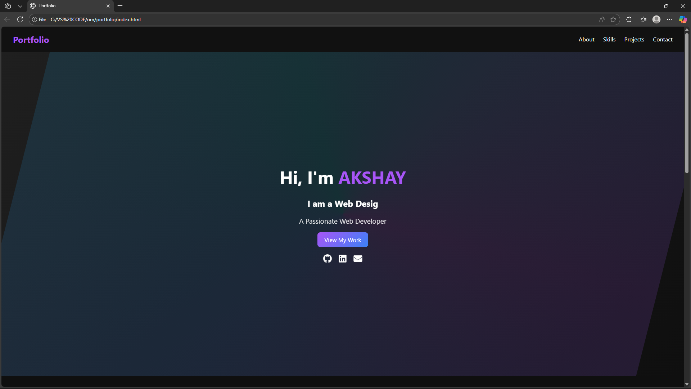

RESULTS AND SCREENSHOTS
3/21/2024 Annual Review
10

Slide 11
CONCLUSION
The portfolio effectively addresses the challenge of professionally showcasing one's own abilities and projects. It improves my online visibility, acts as a digital CV, and offers chances for networking, job hunting, and freelancing. Adding a blog section, a dark/light mode, and live project demos are possible future enhancements.
11

Slide 12
GITHUB LINK
https://github.com/Akshay-14-14/TNSDC-FWD-DP.git

